Slide 1
HELLO

Slide 2
HELLO

Slide 3
HELLO

Slide 5
HAPPY BIRTHDAY

Slide 6
TRAVEL STEPS

Slide 7
PIGLET

Slide 8
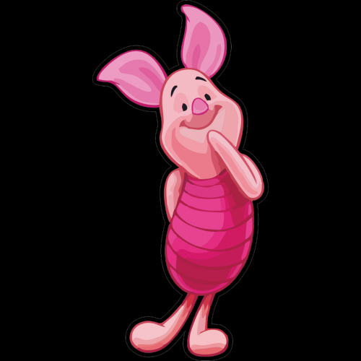
NUMBERS: 22, 130, 41…

Slide 9
RABBIT

Slide 11
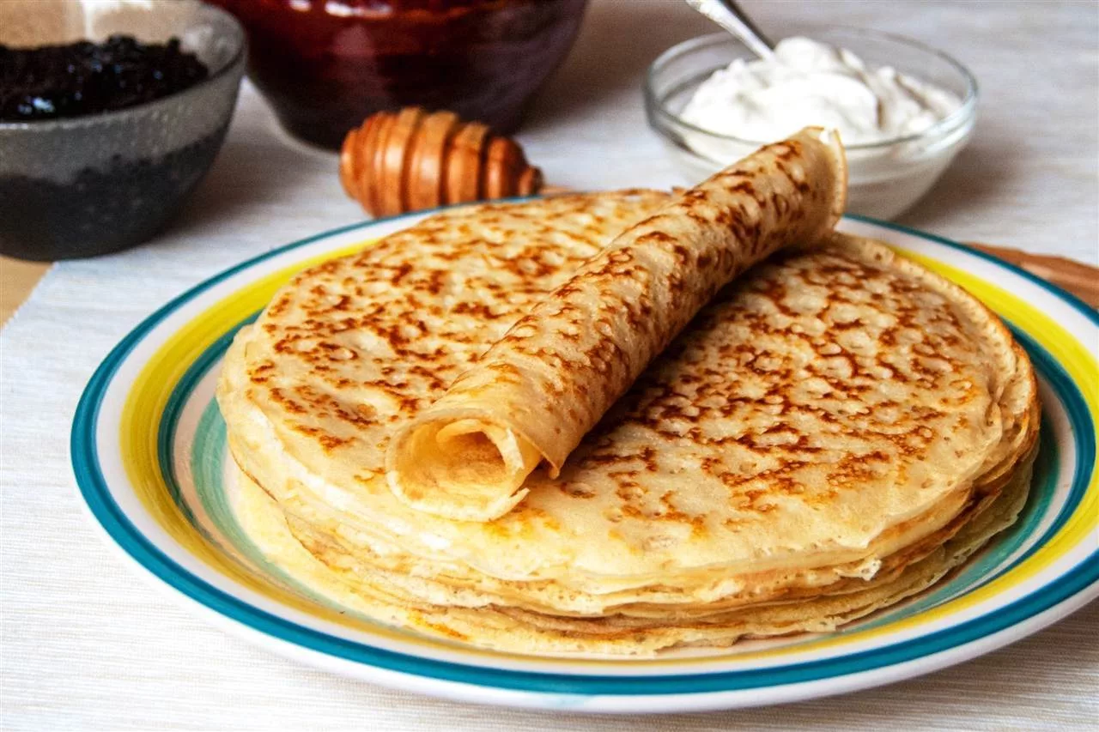

Slide 12
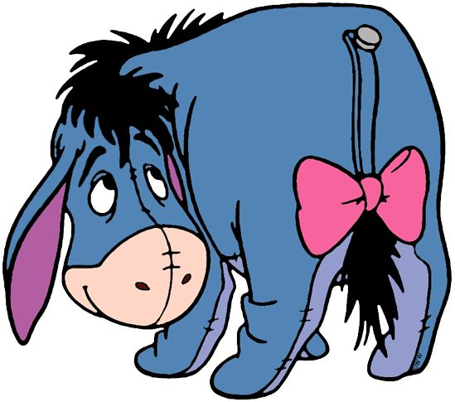
EEYORE

Slide 13
OWL

Slide 14
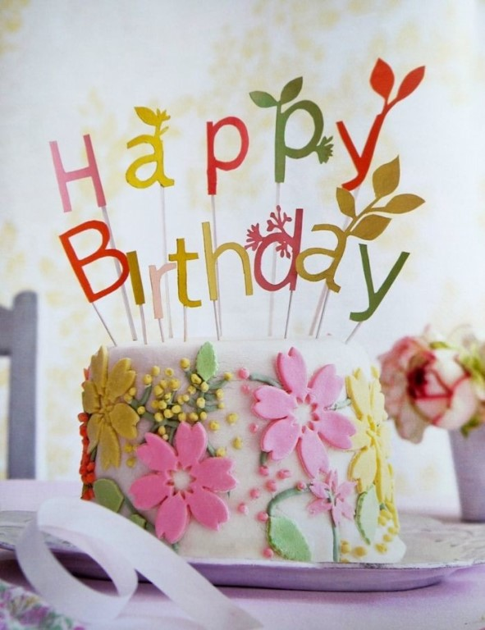

Slide 15
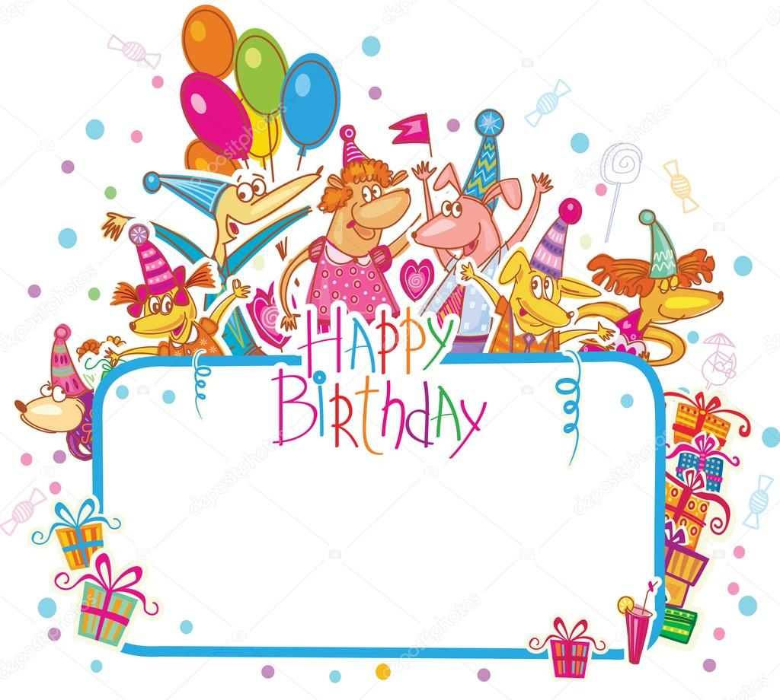

Slide 17
CHRISTOPHER ROBIN

Slide 18
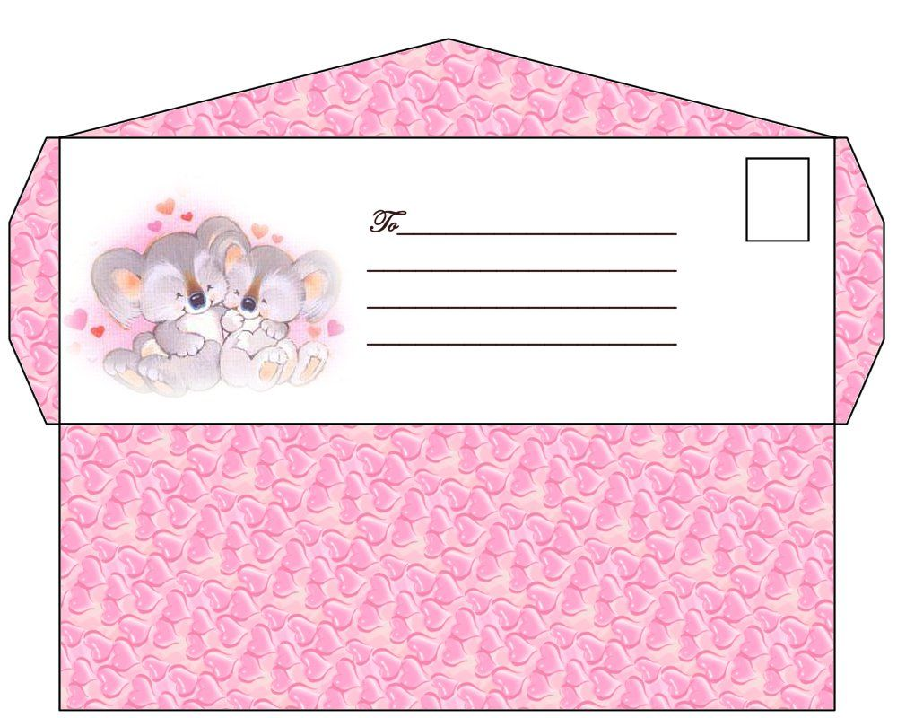

Slide 19
TIGGER

Slide 20
MY BIRTHDAY IS ON…
MY BIRTHDAY IS ON ……

Slide 21
KANGA & LITTLE ROO

Slide 22
I AM…… I LIKE……
I HAVE GOT…..
I LIVE IN ….

Slide 25
THANK YOU FOR ATTENTION!

