Slide 1
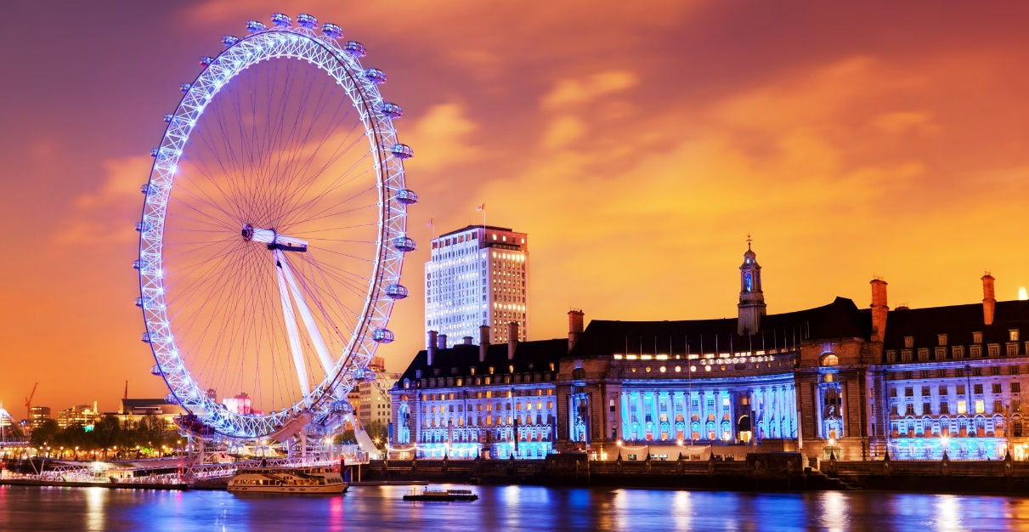
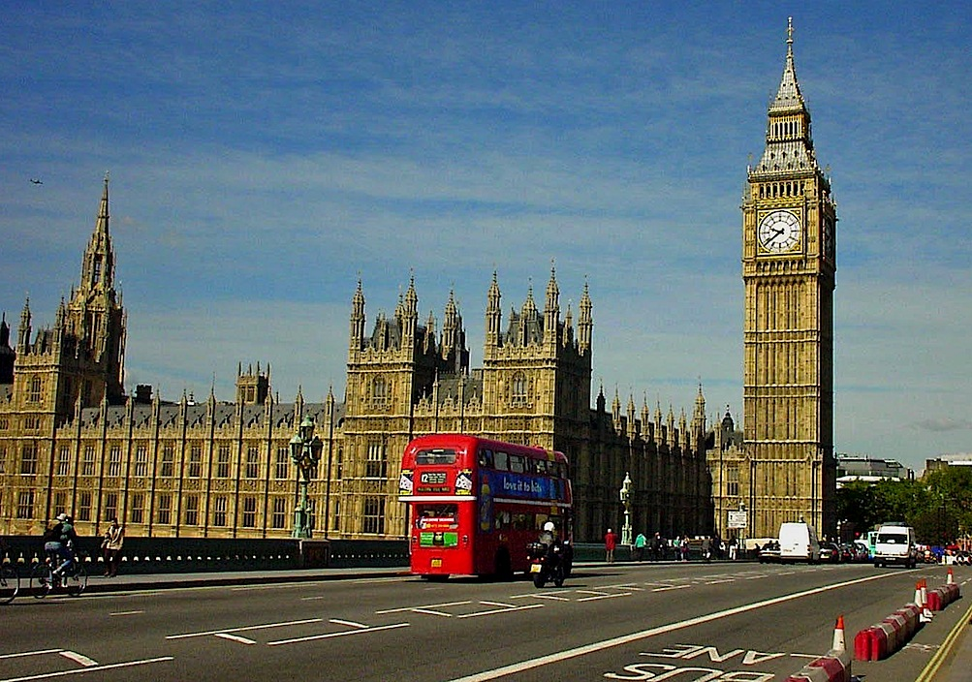

Slide 5
Application Form:
Name______________________
Surname___________________
Age_______________________
Nationality_________________
Home address_______________
microdistrict _______________________
house ________________________
apartament_________________
___________________
______________________

Slide 6
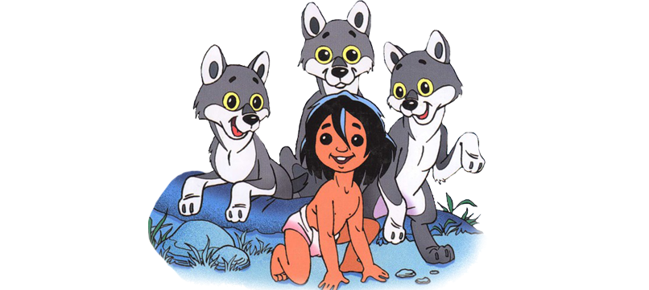

Slide 7
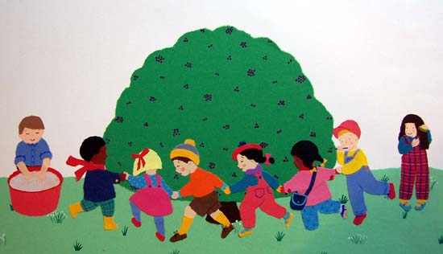

Slide 8
Let`s find a house for each word. We`ll see how you know the rules of reading.
Amazing
Valley
land
Lake
[ æ ]
[ ei ]
_________________ _________________ _________________ _________________ _________________ _________________ _________________
Land
Attractive
Lake
Classic
Valley
Stadium
Classic
Amazing
Jam
Maze
Stadium
Thames
Attractive
Thames
Jam
Maze

Slide 9
Places in London.
Find the pair.
Hyde
Trafalgar
The Tate
Covent
Marble
Square
Garden
Arch
Park
Gallery

Slide 10
A rhyme about mice
Complete the rhyme with the verb to be in the correct form.
I think mice _______very nice.
Their tails_______long.
Their faces______small.
They don`t have any
Chins at all.
Their ears_____pink.
Their teeth______white.
They run about
The house at night.
But I think mice
_______rather nice.

Slide 12
Thank you!

